Slide 1
Predictive Maintenance of Industrial Machinery
CAPSTONE PROJECT
Presented By:-
NAME :- TUSHAR
COLLEGE:- K.R.MANGALAM
DEPARTMENT:- B.TECH CSE(AI AND ML)

Slide 2
OUTLINE
Problem Statement
Proposed System/Solution
System Development Approach (Technology Used)
Algorithm & Deployment
Result (Output Image)
Conclusion
Future Scope
References

Slide 3
Problem Statement
The Challenge: Develop a predictive maintenance model for a fleet of industrial machines to anticipate failures before they occur. This project will involve analyzing sensor data from machinery to identify patterns that precede a failure. The goal is to create a classification model that can predict the type of failure (e.g., tool wear, heat dissipation, power failure) based on real-time operational data. This will enable proactive maintenance, reducing downtime and operational costs.

Slide 4
Proposed Solution
We developed a machine learning-based classification system to:
Analyze sensor data (temperature, torque, speed, voltage, etc.)
Identify patterns that precede failures
Predict failure type in real-time
Enable proactive maintenance
All development and deployment are done on IBM Cloud Free Tier using:
Watsonx.ai Studio (for model development)
Watsonx.ai Runtime (for deployment and real-time inference)

Slide 5
System Approach
Dataset Source:
Collected publicly available predictive maintenance dataset from Kaggle
Includes sensor values like torque, temperature, voltage, and rotational speed
Storage & Access:
Uploaded dataset to IBM Cloud Object Storage
Accessed directly in Watsonx.ai Studio
Development:
Used Watsonx.ai Studio for:
Data preprocessing
Feature engineering
Model training using AutoAI or custom Python code

Slide 6
Algorithm & Deployment
Algorithm Used: Random Forest Classifier – Selected for its high accuracy, support for multi-class classification, and feature importance interpretation.
Input Features: Torque, Voltage, Temperature, Vibration, Rotational Speed Output: Predicted failure type (Tool Wear, Heat Failure, Power Failure, No Failure)
Training: Data cleaned, normalized, and split (80/20). Applied cross-validation and tuned hyperparameters using GridSearchCV. Model trained in Watsonx.ai Studio.
Deployment: Model exported and stored in IBM Cloud Object Storage. Deployed using Watsonx.ai Runtime as a REST API. Accepts real-time sensor data and returns failure prediction with confidence score.

Slide 7
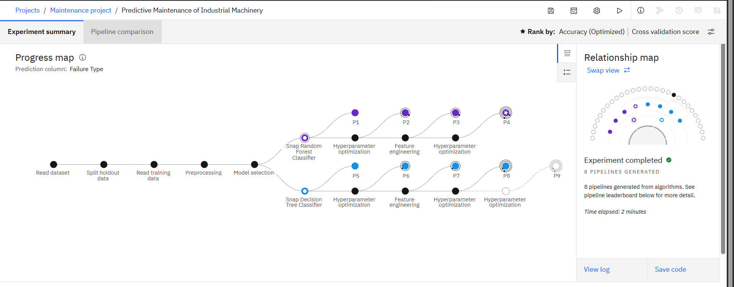
Result

Slide 8
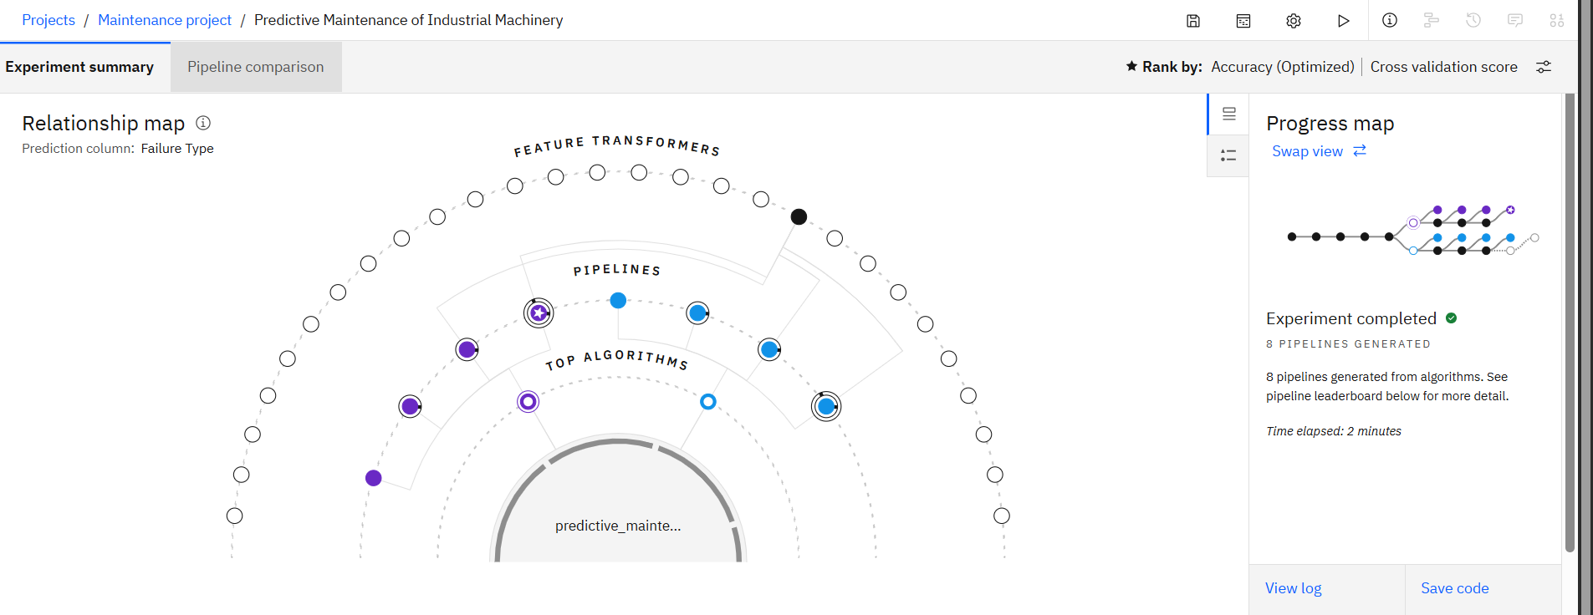
Result

Slide 9
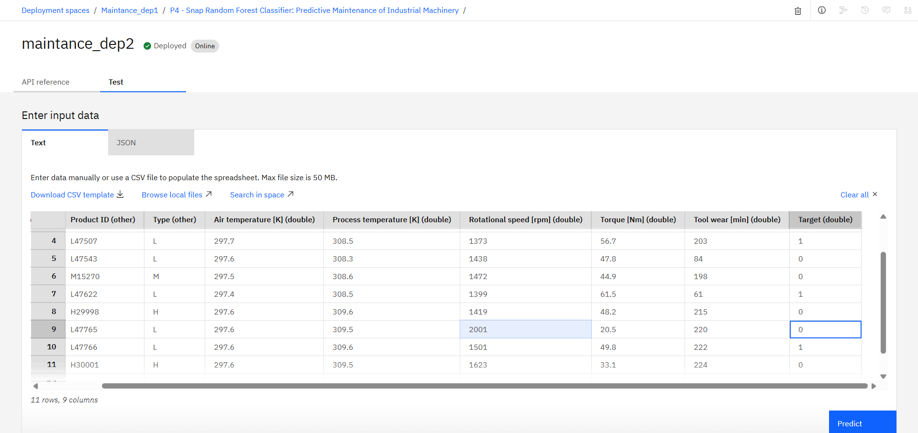
Result

Slide 10
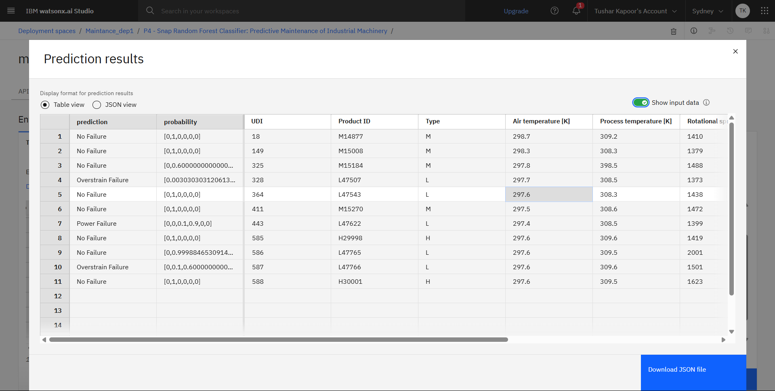
Result

Slide 11
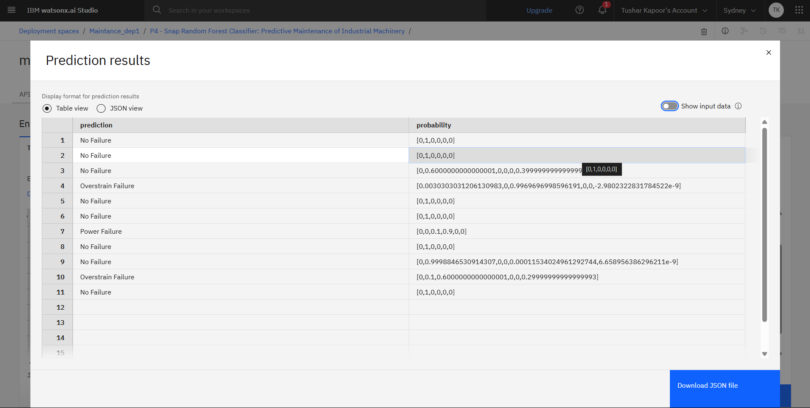
Result

Slide 12
Conclusion
Successfully developed a predictive maintenance system using machine learning on IBM Cloud, leveraging Watsonx.ai Studio and Runtime services.
The model effectively classifies failure types like tool wear, heat failure, and power failure using real-time sensor data.
Enables industries to shift from reactive to proactive maintenance, helping reduce unplanned downtime and increase equipment efficiency.
The project proves the value of integrating AI with cloud technologies for building scalable, real-time solutions for industrial applications.
Demonstrates how cloud-based ML can enhance decision-making, reduce costs, and support digital transformation in manufacturing.

Slide 13
Future scope
Extend the model using deep learning architectures like LSTM or GRU for better time-series failure prediction.
Integrate the system with real-time IoT sensor streams for continuous monitoring and faster anomaly detection.
Enhance the model to estimate Remaining Useful Life (RUL) of machines, enabling more precise maintenance planning.
Deploy the solution on Edge devices for on-site, low-latency predictions without cloud dependency.
Integrate with enterprise alerting systems (e.g., email/SMS/ERP) to automatically trigger maintenance actions or shutdown procedures.

Slide 14
References
Kaggle Dataset: Predictive Maintenance of Machines – Used for model training and evaluation
IBM Watsonx.ai Documentation – For model development, deployment, and runtime APIs
Scikit-learn API Docs – For implementing Random Forest and preprocessing techniques

Slide 15
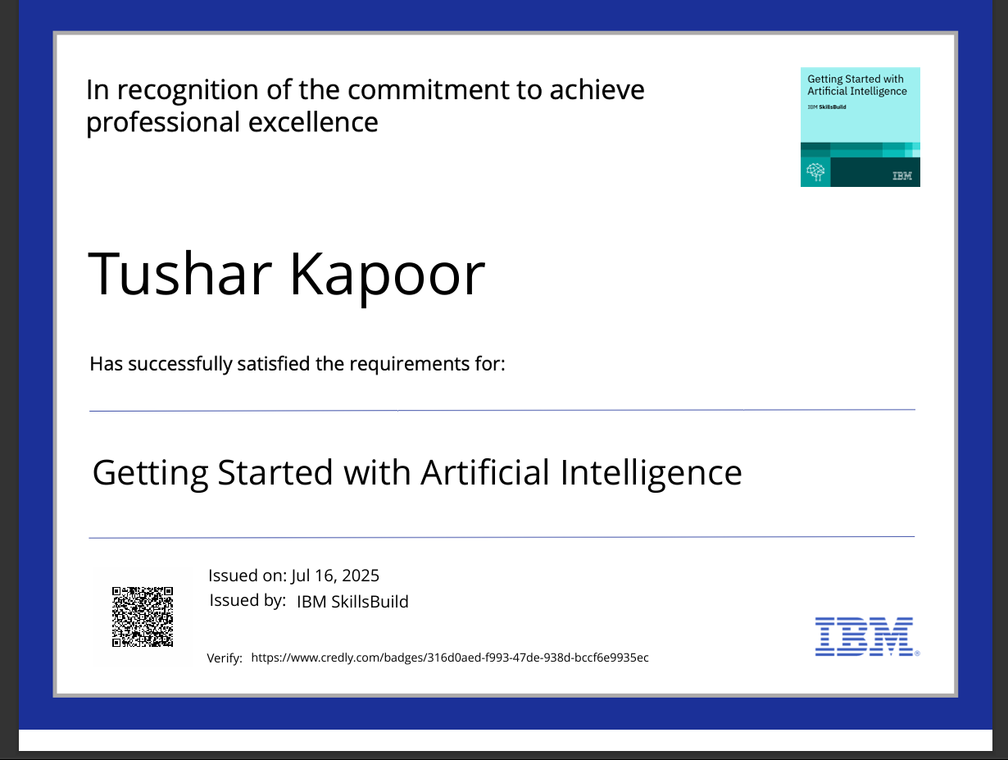
IBM Certifications
Screenshot/ credly certificate( getting started with AI)

Slide 16
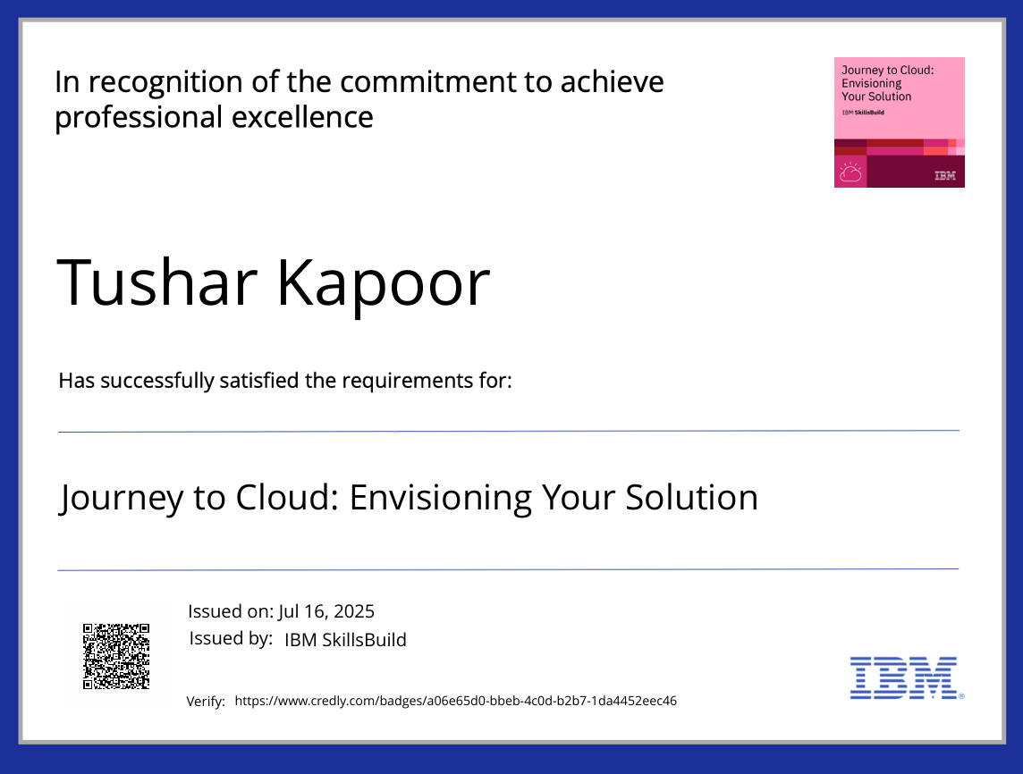
IBM Certifications
Screenshot/ credly certificate( Journey to Cloud)

Slide 17
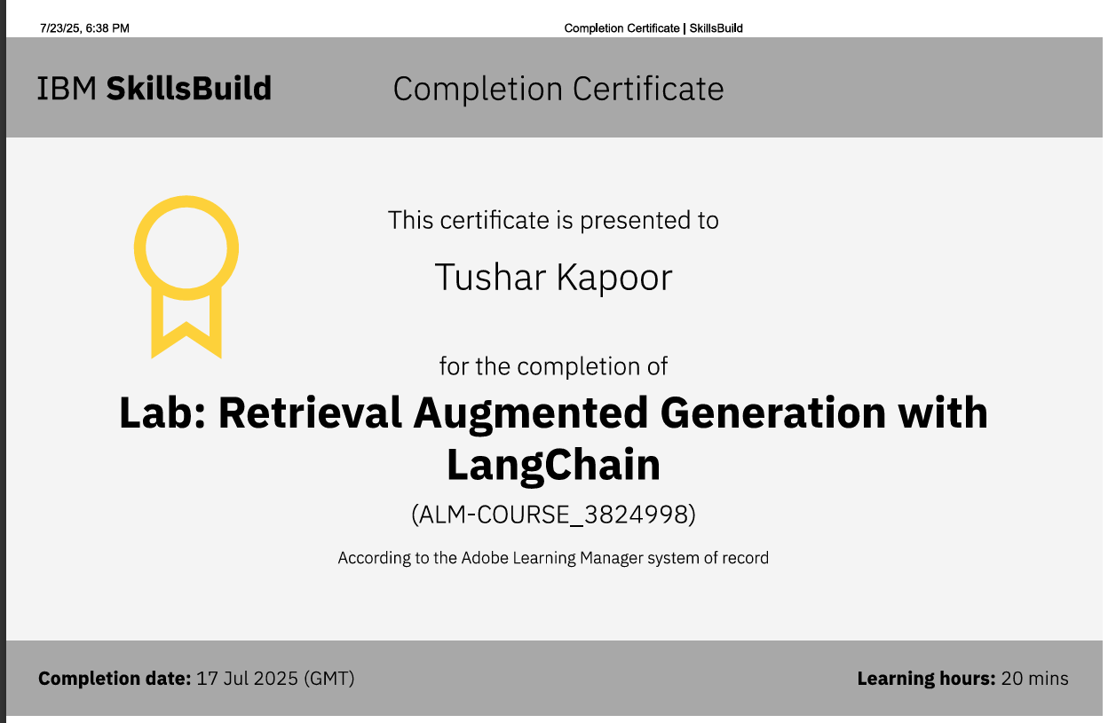
IBM Certifications
Screenshot/ credly certificate( RAG Lab)

Slide 18
THANK YOU

